Slide 1

Hybrid Encryption for Cloud Database Security
ITMS528 – Database Security

Slide 2
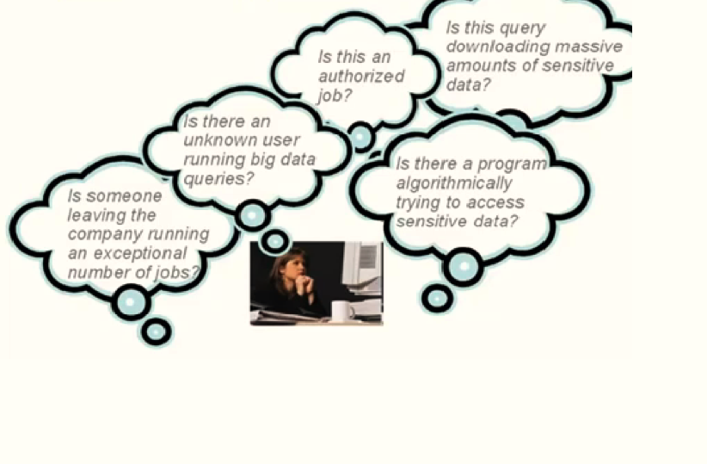
Database Security
As a user of Cloud Databases, these are the Big questions that often keeps you thinking…

Slide 3
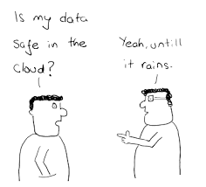
Threats to Cloud Database Security
When enterprise and individuals move their database into the cloud environment, protection of confidential and sensitive information in transit, at rest, and in use becomes critical. The more the data is stored, the more is the concern of the security issue
Some of the threats include failures in provider security, attacks by other customers, availability and reliability issues, and legal and regulatory issues.
Loss of access control in the public cloud environment.

Slide 4
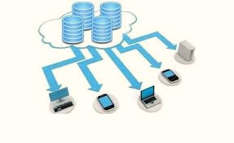
Delivering Cloud Database as a Service (DBaaS)
DBaaS offers the following benefits:
Flexible and Scalable
Service availability to any customer on demand
One-time payment for the service based on the usage without the need of any long-term contract
Complete responsibility lies with the Cloud Service Provider (CSP)

Slide 5
Cloud Key Management System
Key Management is a complex part of Security system in cloud databases.
Every organization defines its own cryptographic keys
A number of secure keys are used in this process. Two types of KMS exists:
Remote Key Management System
Enterprise Key Management System
Various states in key management system are involved in hybrid encryption which help in managing the security system of the cloud databases

Slide 6
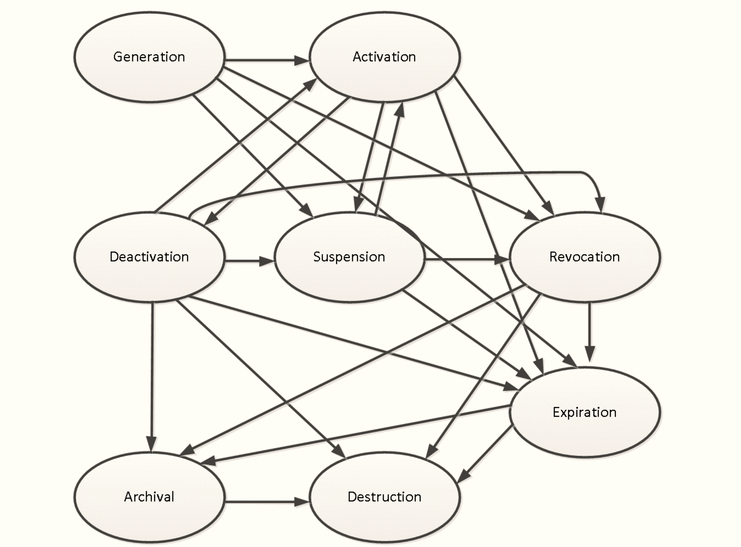
States in Key Management System
Various key management states include:
Generation
Activation
Deactivation
Suspension
Revocation
Archival
Expiration
Destruction

Slide 7
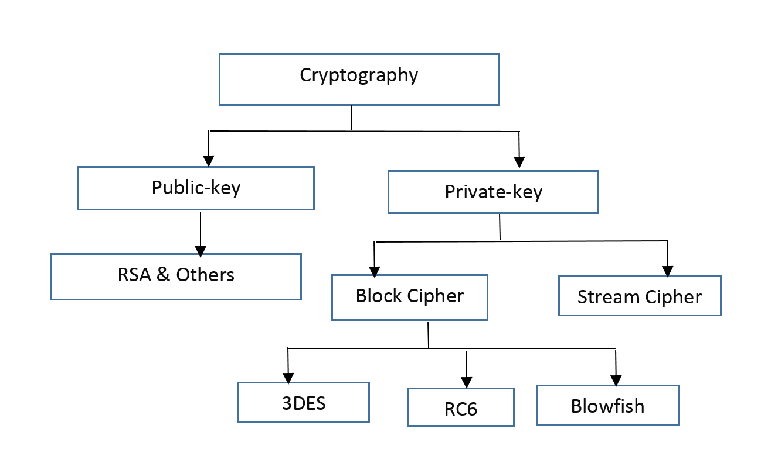
Cloud Hybrid Cryptographic Mechanisms
Cloud databases have a number of cryptographic mechanisms. These mechanisms combine together to form hybrid encryption.

Slide 8
Cloud Hybrid Cryptographic Mechanisms (Contd.)
Triple DES (3DES) – An encryption algorithm that encrypts data three times and hence the name. This mechanism uses different keys that may be unique or identical. 3DES works in a way that it breaks the user-provided key into three sub keys, and then fills the keys in a way so that they are 64-bit long
RSA – An asymmetric algorithm that is commonly called Rivest, Shamir, Adleman. A commonly known public-key cryptographic mechanism.
Random Number Generator – Random number are generated for the purpose of creation of random keys. They are generated using random keys.

Slide 9
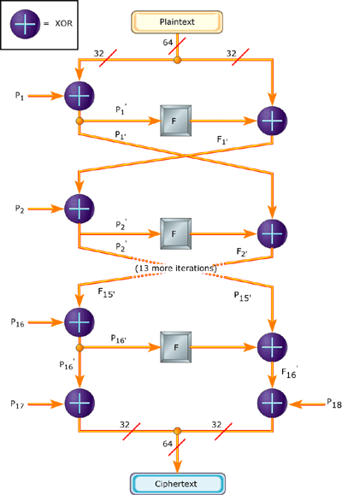
Hybrid Encryption Mechanism
Blowfish is a symmetric block algorithm and has three main components:
Fiestal Network
16 rounds of iterative encryption
Decryption Functional design
This algorithm is a hybrid one and uses a combination of RSA and SRNN algorithms.

Slide 10
Hybrid Encryption Mechanisms (Contd.)
SRNN is a public key cryptographic algorithm that uses two prime numbers along with two short-range natural numbers in the pair of keys. SRNN is used for secure communication between users and cloud servers.

Slide 11
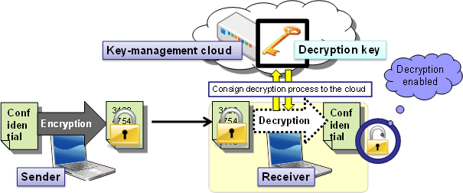
Hybrid Encryption Phases
A combination of symmetric and asymmetric algorithm leads to hybrid encryption methodology. Two or more encryption and decryption methods are involved in this process along with a strong Cloud Key Management System.

Slide 12
Hybrid Encryption Phases
Two types of hybrid encryption phases:
Encryption phase
Decryption phase
These encryption phases provides database file security within a cloud system.

Slide 13
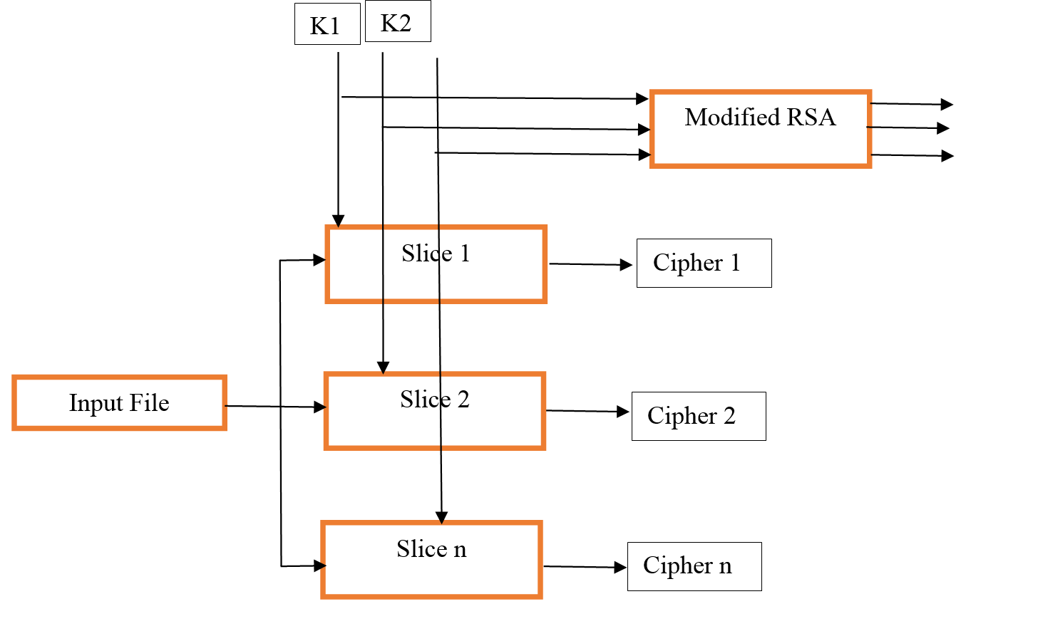
Hybrid Encryption Phases (Contd.)
Encryption phase

Slide 14
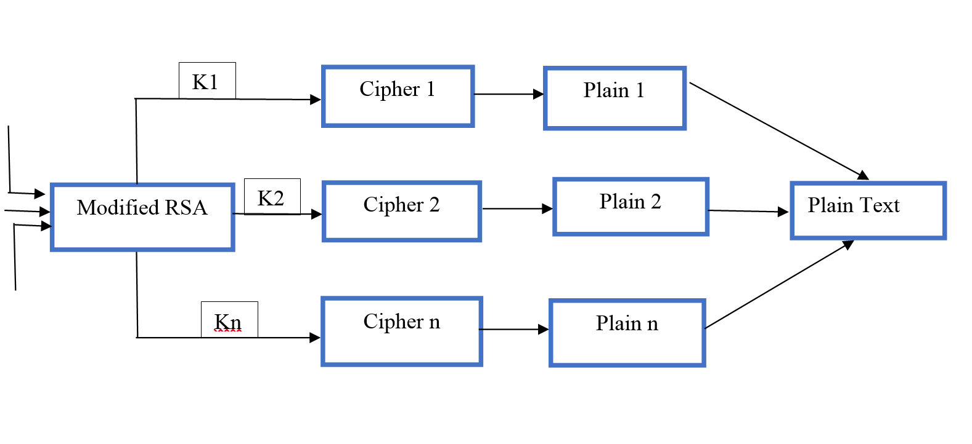
Hybrid Encryption Phases (Contd.)
Decryption phase

Slide 15
Future Enhancements
When the size of the data increases, the amount of computation time also increases.
One can decrease the computation time of the large amounts of data by using a method where the decryption process is carried out using the .NET framework.
In this method, the private key tends to corrupt occasionally. One can resolve this error by creating a customized encoding methods built in .NET framework

Slide 16
Thank You!

